Slide 1
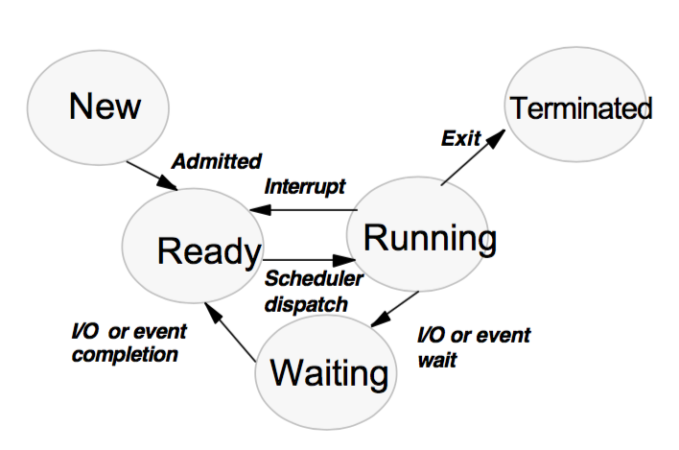
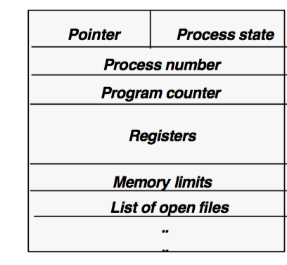
Borko Furht Florida Atlantic University
Lecture 2
Process Management
Processes and Threads

Slide 2
Process Concept
Process is a program in execution
A system consists of a collection of processes
Operating system processes execute system code
User processes execute user code
Processes can execute concurrently (on a single or multiple CPUs)
CPU switches between processes.

Slide 3
Process Definition
Process is a program in execution, which includes: program code, the current activity (value of program counter), the contents of processor’s registers, the process stack, temporary data (subroutine parameters, return addresses and temporary variables) and a data section containing global variables.
A program is not a process – it is a passive entity (file on the disk).
A process is an active entity.

Slide 4
Process States

Slide 5
Description of Process States
NEW: The process is being created.
RUNNING: Instructions are being executed.
WAITING: The process is waiting for some event to occur (an I/O completion or a reception of a signal).
READY: The process is waiting to be assigned to a processor.
TERMINATED: The process completed the execution.

Slide 6
Process Control Block (PCB)
Each process is represented in the OS by the data structure called Process Control Block or Task Control Block

Slide 7
Description of the PCB Fields
Process State: new, read, running, waiting, etc.
Program Counter: the address of the next instruction to be executed for this process.
CPU Registers: depending on the CPU architecture – GP registers, stack pointers, status register.
CPU Scheduling Information: process priority, pointers to scheduling queues, other scheduling parameters.

Slide 8
Description of the PCB Fields - More
Memory-Management Information: the value of the base and limit registers, the page map tables (or segment tables).
Accounting Information: the amount of CPU and real-time used, time limits, account numbers, job or process number, etc.
I/O Status Information: the list of I/O devices allocated to the process, a list of open files, etc.

Slide 9
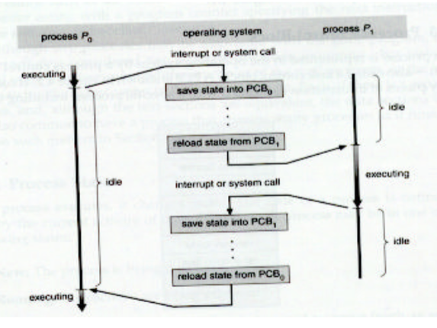
CPU Switch from Process to Process

Slide 10
Time Calculation
Context Switch Time (TCS)
TCS = TS + TR
CPU Switch Time (TCPU)
TCPU = TS + TSC + TR
Where TSC is scheduling time

Slide 11
Scheduling Queues
Job queue: contains all processes in the system.
Ready queue: the processes residing in the main memory and waiting to execute.
Device queue: the list of processes waiting for a particular I/O device
Ready queue is stored as a linked list.
Ready queue header has pointers to the first and last PCBs in the list. Each PCB has a pointer field to the next process in the ready queue.

Slide 12
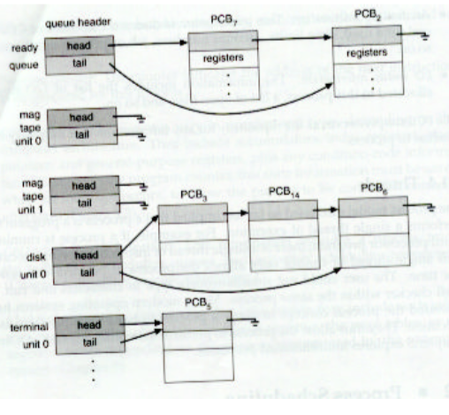
Ready Queue and Various I/O Device Queues

Slide 13
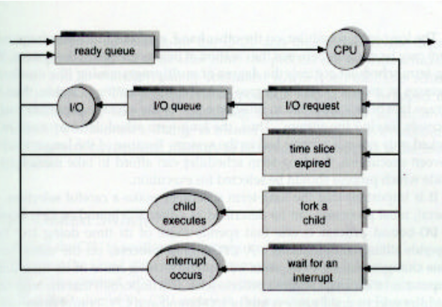
Queuing Diagram Representation of Process Scheduling

Slide 14
Description of the Queuing Diagram
A new process is initially put in the ready queue.
It waits until it is dispatched (by the schedule) for execution on the CPU.
The process could issue and I/O request – placed in an I/O device queue.
The process could create a new subprocess and wait for its termination.
The process could be removed from the CPU as a result of an interrupt and put back in the ready queue.

Slide 15
Schedulers
Batch system: there are often more processes submitted than can be executed immediately.
Some processes are spooled on a disk for later execution.
Long-term scheduler (Job scheduler): selects processes from this pool and loads them to memory for execution.
Short-term scheduler (CPU scheduler): selects from ready processes to execute on the CPU.

Slide 16
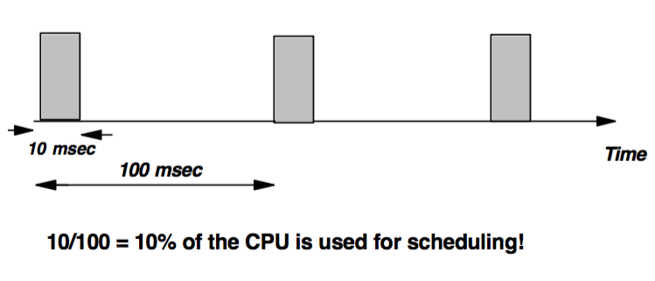
Short-Term Scheduler
Executes very frequently – every 100 milliseconds.
It must be very fast.

Slide 17
Long-Term Scheduler
Executes less frequently – several minutes.
It controls the degree of multiprogramming (the number of processes in the memory).
Typically: average rate of process creation = the average departure rate.
It should select a good process mix of I/O-bound and CPU-bound processes.
Time-sharing systems often have no long-term scheduler.

Slide 18
Context Switch
Switching the CPU from one to another process.
Requires saving the state of the old process and loading the saved state of the new process.
Context switch time: 1-1000 microsec.
Depends on the hardware support.
Complex OS require more work – longer context switch times.
Context switching is a performance bottleneck (solution are threads!)

Slide 19
Operations on Processes
Process creation
Process termination
Suspend/resume a process
Change a process’ priority
Block a process
Wake up a process
Dispatch a process

Slide 20
Process Creation
During the execution, a process can create another process.
Creating process is parent and new processes are children of that process.
The parent can continue to execute concurrently with its children.
The parent can wait until some or all children have terminated.

Slide 21
Process Termination
A process terminates when it finished its last instruction.
All process resources (memory, open files, I/O buffers) are reallocated by the OS.
A parent can terminate the execution of one of its children for various reasons.

Slide 22
Cooperating Processes
Concurrent processes executing in the OS can be independent or cooperating process.
Independent process does not affect other processes – it does not share data with other processes.
Cooperating processes can affect or be affected by the other processes executing in the system – they share data with other processes.

Slide 23
Reasons for Process Cooperation
Information sharing: several users are interested in the same file – concurrent access to these resources.
Computation speedup: on multiple processor systems we divide a task into a group of parallel subtasks.
Modularity: The system is divided into modules, separate processes, that collaborate among them.
Convenience: An individual user may have many tasks: editing, printing and compiling in parallel.

Slide 24
Threads
A thread (or a lightweight process [LWP]) is a basic unit of CPU utilization.
It consists of a program counter, a register set, and a stack space = a task.
Peer threads share code section, data section, and OS resources (open files and signals).
Context switch among threads is much simpler than among heavyweight processes.
Thread switch requires a register set switch only.

Slide 25
Threads vs. Processes
PCB for Process
PCB for Thread
(LWP)
Pointer | Process State
Process
Program Counter
Registers
Memory Limits
List of Open Files
Program Counter
Registers
Stack Space

Slide 26
User-Level Threads
Implemented in some OS – thread switching does not need to call the OS and to cause an interrupt to the kernel.
Switching between user-level threads can be done independently from the OS – very quickly.
Threads can be in one of several states; ready, blocked, running or terminated.
Threads can create child threads.
Threads are not independent of one another.

Slide 27
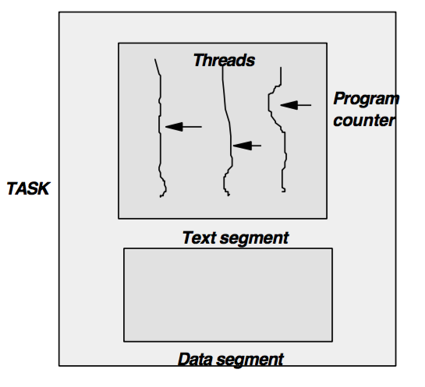
Multiple Threads within a Task

Slide 28
Example of Threads
Web Browser
T1
T2
Displays
images & text
Retrieves data
from the network

Slide 29
Example of Threads
Word Processor
Display
Graphics
T1
T2
T3
Performing Spelling
and Grammar Checking
Responding to
Key Strokes

Slide 30
Benefits of Multithreaded Programming
Responsiveness
Process can be blocked or doing a lengthy operation.
With multithreading, an important thread (interactive operation) is immediately activated.
Resource Sharing
Scalability
Economy

Slide 31
Kernel-Supported Threads
A set of system calls is provided.
Examples: Mach and OS/2 operating systems.
User-level threads do not involve the kernel – they are faster to switch than kernel-supported threads.
However, any call to the OS causes the entire process to wait because the kernel schedules only processes.

Slide 32
Scheduling Threads
Consider two processes: Process A with 1 thread, and Process B with 100 threads.
User-level threads: each process receives the same time slice.
Kernel-supported threads: each thread may be scheduled independently, so process B can receive 100 times the CPU time than process A.

Slide 33
Single-threaded and Multithreaded Processes
CODE
DATA
FILES
CODE
DATA
FILES
Registers
Registers
Registers
Registers
Stack
STACK
STACK
STACK
THREAD
THREAD

Slide 34
Concurrent Execution on a Single Core System
Single
core
T1 | T2 | T3 | T4 | T1 | T2 | T3 | T4 | T1 | …
Time

Slide 35
Parallel Execution on a Multicore System
T1 | T3 | T1 | T3 | T1 | …
T2 | T4 | T2 | T4 | T2 | …
Time

Slide 36
Multithreading Models
Many-to-One Model
One-to-One Model
Many-to-Many Model
Two-Level Model

Slide 37
Many-to-One Model
Supported and managed by OS
Drawback: unable to take advantage of multiple processing cores
User thread
K
Kernel thread

Slide 38
One-to-One Model
Allows multiple threads to run in parallel on multiprocessors
Linux, along with the family of Windows operating systems, implement
the one-to-one model.
User thread
K
K
K
K
Kernel thread

Slide 39
Many-to-Many Model
A smaller or equal number of kernel threads.
User thread
K
K
K
Kernel thread

Slide 40
Two-Level Model
Hybrid approach
Solaris 9
User thread
K
K
K
Kernel thread
K

